Slide 1
Pronunciation of t and th

Slide 2
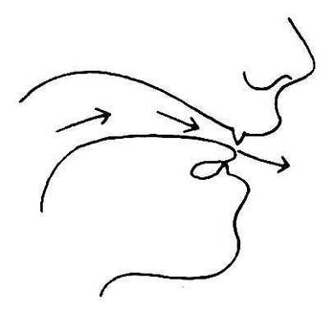

Slide 3
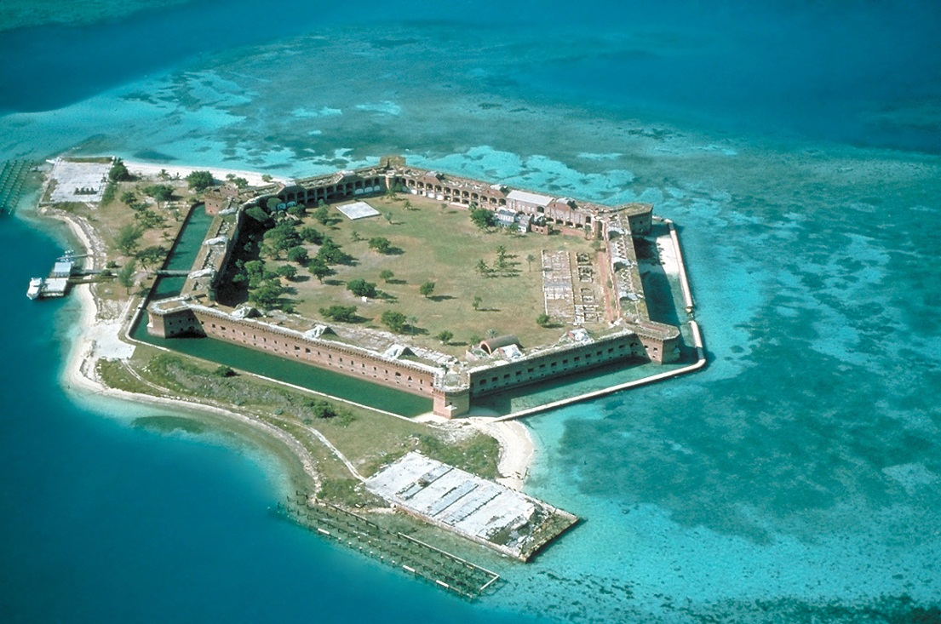
Fourth
4th
Fort

Slide 4
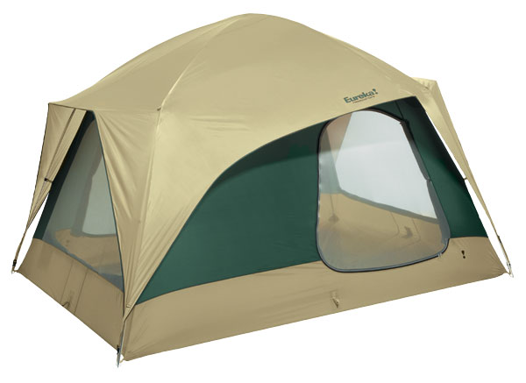
tenth
10th
tent

Slide 5
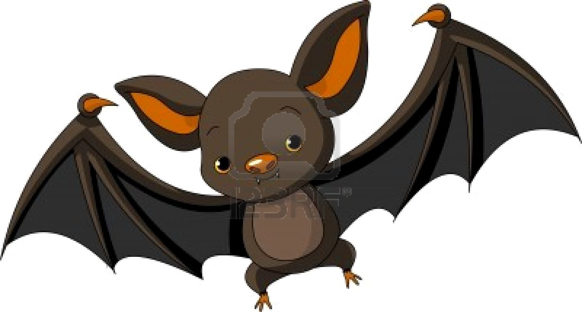
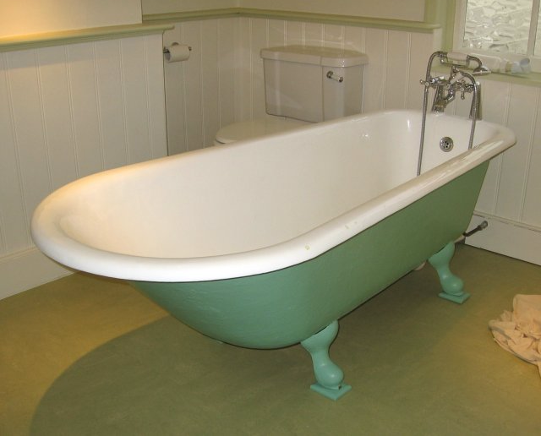
Bat
Bath

Slide 6
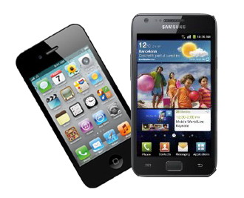
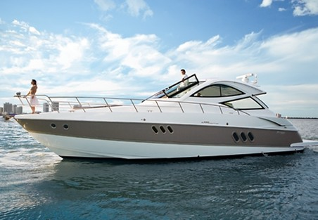
Boat
Both

Slide 7
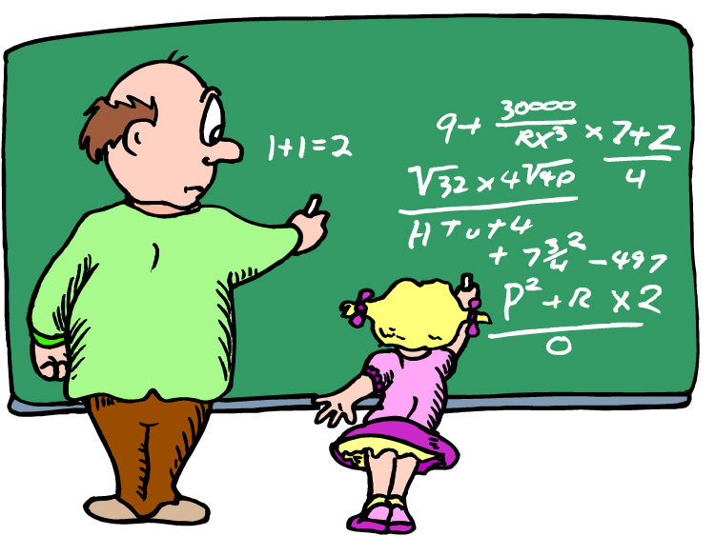
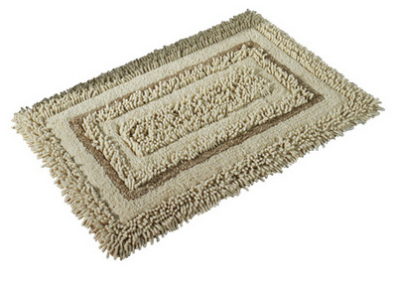
Mat
Math

Slide 8
Tongue Twister t - th
I bet Beth doesn´t make her bed.
There is a myth about a mitt turning meat in the fourth north.
Thick ticks on three trees brought broth to ten thin tin men.

